Slide 1
Hardware, Network, and Data Transfer
Task |  | R&D Area
1.1 |  | Data Management
1.2 |  | User Interface and Search
1.3 |  | Hardware & Network
1.4 |  | Data Transfer
1.5 |  | Installation (Containerized)
1.6 |  | Authentication & Authorization
1.7 |  | Federation
1.8 |  | Quality Control & Assurance
1.9 |  | Replication
1.10 |  | Distributed Search
1.11 |  | Metrics
1.12 |  | User Notification
1.13 |  | Long-tail Publication
1.14 |  | Distributed Computation
1.15 |  | Data Citation
2.1 |  | Provenance Capture
2.2 |  | Workflow
2.3 |  | Dynamic Resources
2.4 |  | In situ Analysis
2.5 |  | Machine Learning
2.6 |  | UQ
2.7 |  | Analytical Modeling
2.8 |  | Mobile Apps
Current capability status:
 | Usable
 | Prototype
 | Research activity
Cameron Harr
Livermore Computing
2017 Triennial Project Review, Potomac, MD
June 8 – 9, 2017

Slide 2
Overview
Tier1 site requirements
Globus and data transfers
Front-end servers
Back-end storage devices
Data Transfer Nodes
Network overview
PerfSONAR
Synchro-Data (Synda) and data replication

Slide 3
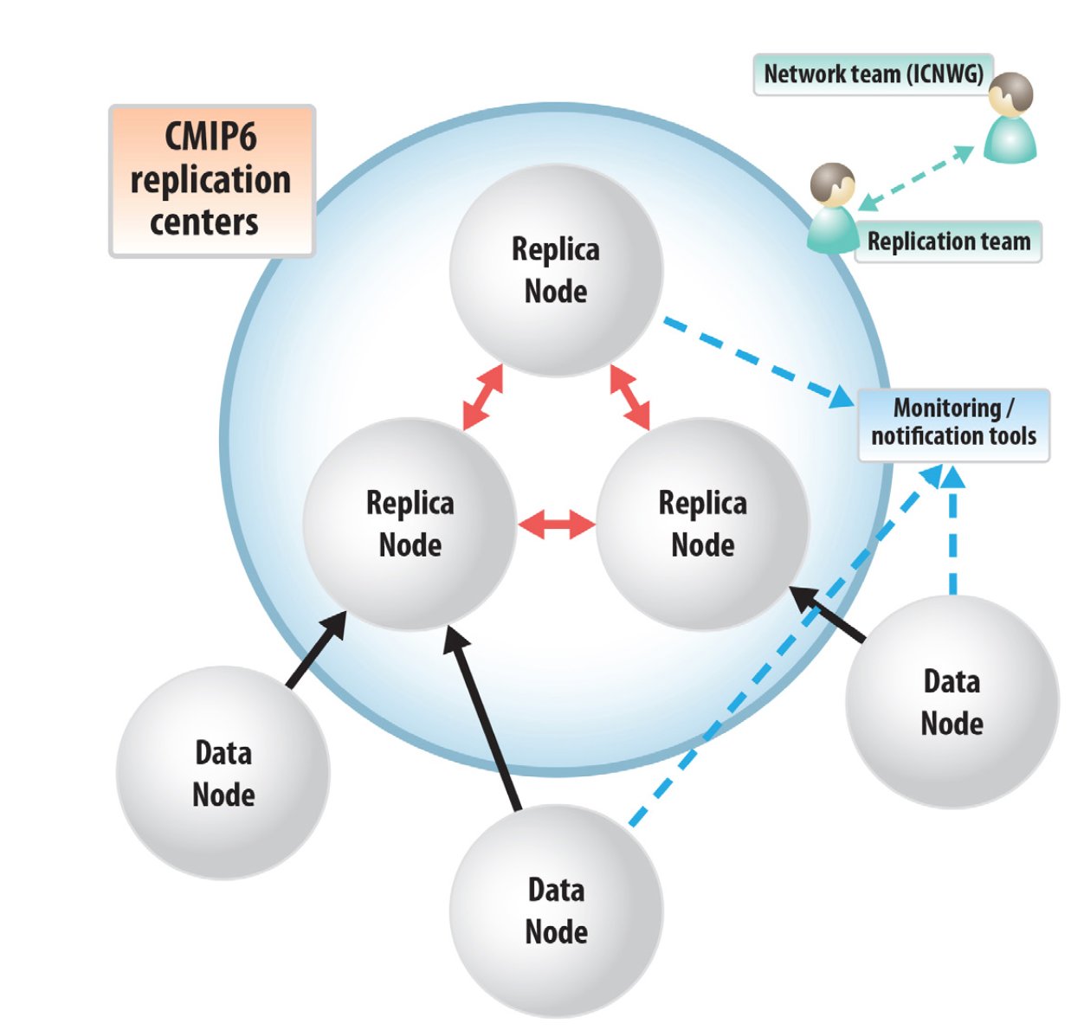
Tier 1 site requirements
Storage (1.3): uncompressed
CMIP1: 1GB; CMIP2: 500GB; CMIP3: 35TB:
CMIP5: ~2PB; CMIP6: 40+ PB
File system-level or NetCDF compression advantageous
Update > 99%
Transfer rates (1.4)
Sustained 485-970 MB/s (40-80 TB/day) between Tier 1 sites
Goal: 1PB/wk = sustained ~1.8 GB/s
Not met
Requires high-performing storage at both ends and 40Gb/s Ethernet
Testing @ LLNL reached > 800 MB/s
Only reachable with multiple, simultaneous transfers
Full suite of ESGF services
perfSONAR, Synda, Globus, publication, dashboard, QC, CoG, etc.
Primary leverage site supporting Tier 2 sites
Hardware
~2 PB Storage disk storage
Front-end servers
Test compute cluster
Data Transfer Nodes (DTNs) in a “Science DMZ”
LLNL
CEDA
DKRZ
Model Center 3
Model Center 1
Model Center 2
Notes:
Storage:
CMIP5 storage already at capacity and near end-of-life as well. We have a need to address a CMIP6 requirement of roughly 30PB AND migrate existing, legacy, data as well.
Our plan is to reach 20PB over the next 4 years, but budget constraints may impact the amount of data we are able to store
We are already compressing data to store as much as possible with limited resources
Transfer Rates
Tests as far back as 2014 have shown good results but we are well behind our goal of being able to transfer 1PB/wk.
ICNWG hampered by limited personnel and budgets at various sites
Major storage and network upgrades may be needed to deploy 40Gb Ethernet and high-speed storage
Better rates are seen when multiple data streams are run at a time. Globus and GridFTP can do this relatively easily.
Network efforts are currently focused on transfer software configuration and testing rather than rates.

Slide 4
Globus and file transfers
What is Globus?
US-sponsored project (seeking to support itself)
Platform for remote file transfer and sharing
ESGF uses Globus Toolkit and Globus Online (1.3, 1.4)
Provides ability to securely browse and share files across sites
Allows secure, high-performance, parallel file transfer mechanism
Optimized for large-file and many-file transfers
Notes:
Globus:
The Globus project provides a suite of software and services aimed at geographically distant compute resources.
Those services include job management and submission across remote systems and transfers of large amounts of data.
Many organizations around the world have contributed to the Globus project, with Argonne NL and UofChicago being premier contributors
Many Globus services are free to use, though in the interest of self-sustainment, Globus does provide some subscription-based products
ESGF && Globus
ESGF IDP and Data nodes use the Globus Toolkit (ver. 6) to authenticate and transfer climate data between sites
Uses GridFTP and MyProxy
GridFTP allows for eficient, multi-stream data transfers for authenticated users
Globus Online allows for increased parallelism of data transfers by using multiple streams on multiple nodes.
Will be used by DTN nodes once data is republished with DTN URLs

Slide 5
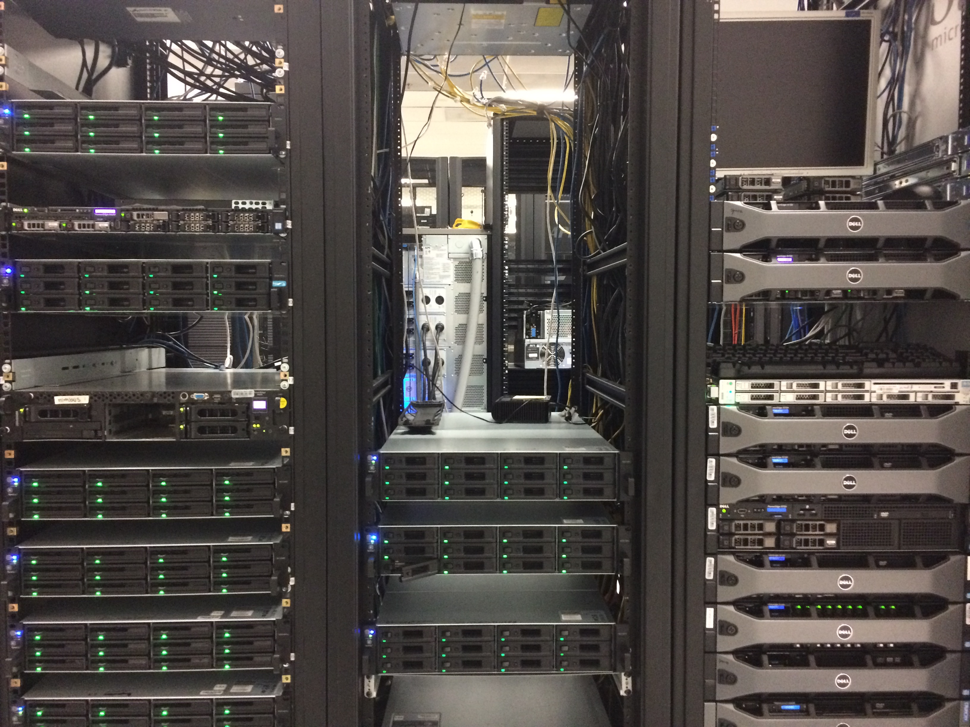
Front-end servers
ESGF-related servers (1.4):
18 dedicated ESGF servers
Plus additional 4+ servers with shared duties
Provide various:
IDP nodes authenticates users
Index nodes catalog and publish available data
Data nodes serve data
Synda node ingest replica data
Two distinct federations: Production and Test
Additional CPU/GPU systems under consideration
Service / Compute
Notes:
The ESGF-dedicated nodes are:
aimsdtn[1-6]
Aimsdtn[2-4] are DTN
Aimsdtn[5-6] are Synda
Aims[2-3]
Pcmdi[7,9,11]
Greyworm[1-7]
Current nodes are meeting needs, but LLNL is considering additional compute nodes, including GPGPU nodes

Slide 6
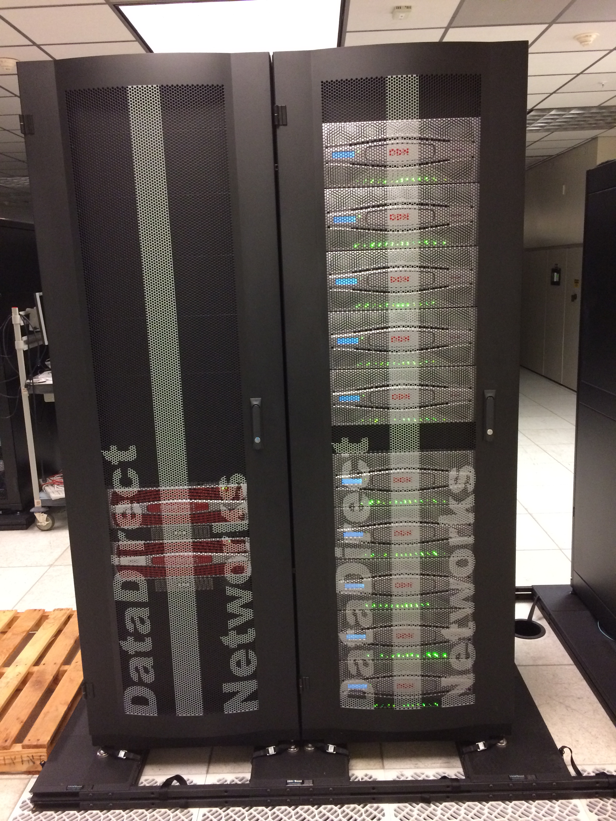
Back-end storage
Legacy Climate Storage Systems
CSS01: ~0.75PB, 76% full
CSS02: ~1PB, 95% full
Both near EOL, but slated for repurposing
New Climate Storage File System (CSS03) (1.4)
~2PB with planned expansion to >20PB over 3 years (budget dependent)
Holds compressed CMIP5 data from CSS01/CSS02 and future CMIP6 data
Runs IBM SpectrumScale (GPFS) 4.2 with native clients
Uses 40Gb/s Ethernet infrastructure
Clients connected via 10Gb/s Ethernet
CSS F/S
Notes:
The new 2PB CSSFS system is based on the DataDirect Networks (DDN) GS12KX-E, an appliance running SpectrumScale (GPFS).
Existing CSS01 and CSS02 systems are slated to be wiped and repurposed as ESGF scratch and publishing space.
The CSSFS system currently has 3 file systems; css03, cscratch, user_pub; but user_pub and cscratch may be moved to the old DDN 9900 systems when they are repurposed
Clients needing access to css03 file systems have native gpfs client connections (i.e., not NFS)
Expansion will happen by buying another set of controllers this year and then adding lots and lots of disks as budget permits over the coming years

Slide 7
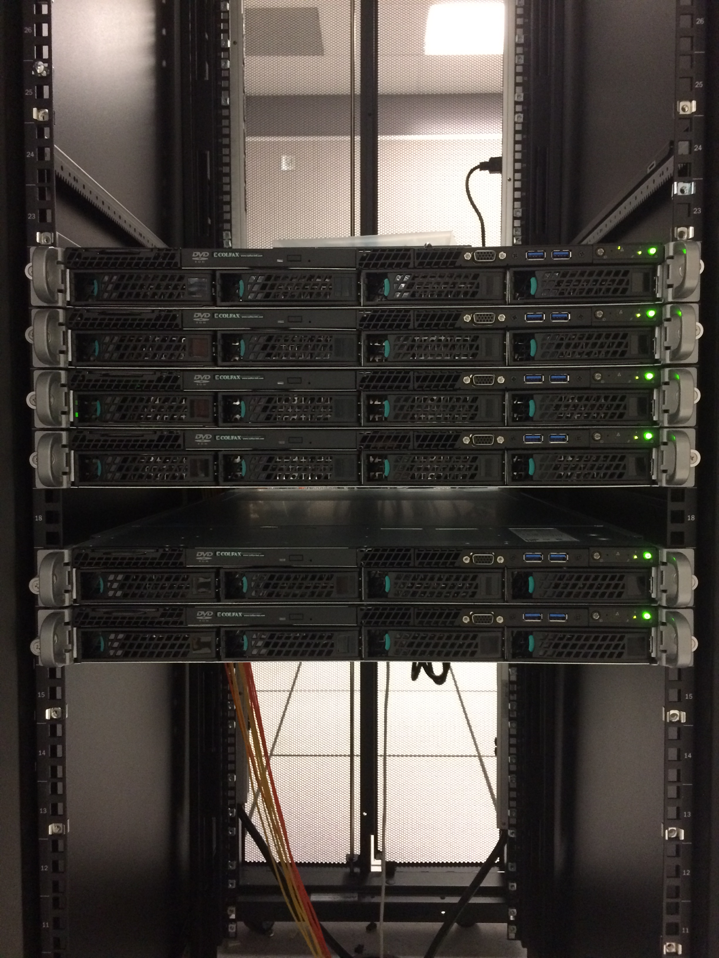
Data Transfer Nodes (DTNs)
Dedicated file transfer nodes (1.4)
Reside on 100Gb/s Science DMZ
3x Globus transfer nodes (when data re-published)
Will allow parallel, high-speed, file transfers to other sites
2x Synda data-ingest nodes
Replicate data from other sites to LLNL
Protocols supported
Globus
GridFTP
Http
Aimsdtn
Notes:
The Data Transfer Nodes (DTNs) site on the 100Gbps ES Net Science DMZ.
aimsdtn[1-6]
Aimsdtn[2-4] are DTN
Aimsdtn[5-6] are Synda
* Currently, the URLs for published data all refer to a single data node inside the LLNL enclave. Once the data is republished for Globus transfers, data can be pulled through the DTNs at much higher speeds.

Slide 8
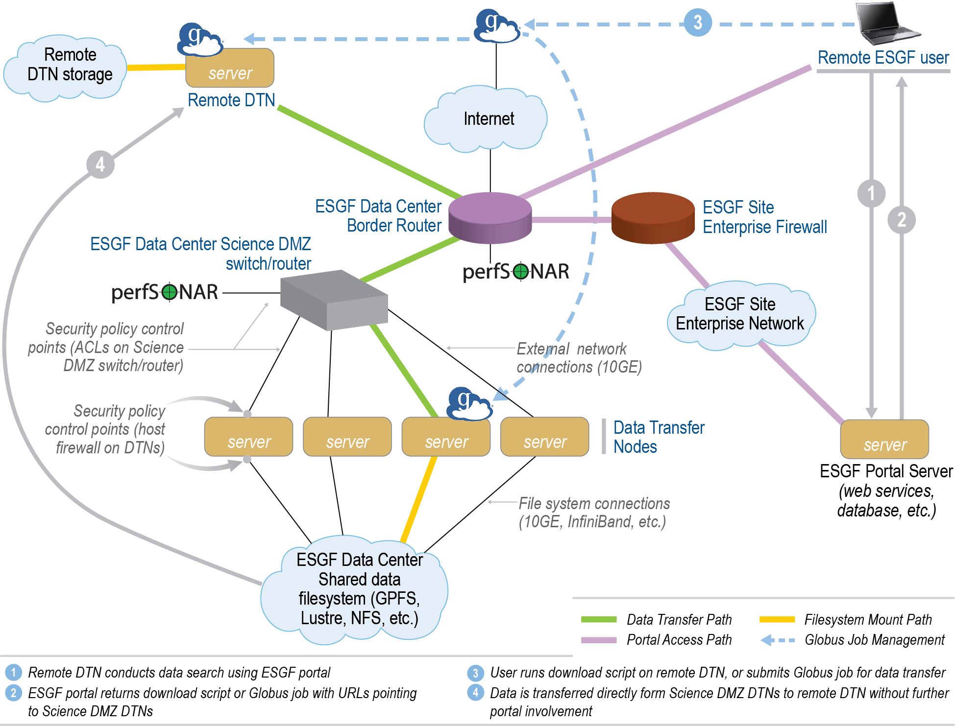
Network overview
Notes:
DTN/Synda nodes are in Science DMZ for max performance
Have 10 Gb/s connections
Effort to republish URLs to enable Globus transfers on DTN Nodes
Nodes inside firewall limited to 1Gb/s external network
Include ESGF data and index
nodes

Slide 9
PerfSONAR
Continuous , centralized, monitoring service of ESnet sites
Connection status
Throughput
Report generation for baselines and aberration analysis
Website and Dashboards:
https://icnwg.llnl.gov
Notes:
PerfSONAR run by Esnet team with PerfSONAR nodes at each site. This allows a great way to view both instantaeous and historical status of the network as well as status of changes.

Slide 10
Synda and data replication
Intelligent ESGF data replication tool
Searches and replicates specific datasets by attributes including variables and source
Maintains database of transactions and “installed” datasets, allowing fine-grained metadata searches
Supports multiple protocols
Wget/HTTP, GridFTP, Globus
Developed by IPSL
Tier 1 sites currently performing site-site federation testing with Synda
Notes:
Synda is the chosen method for Tier1 site-site replication of ESGF data
Test federation set up between Tier1 sites to test replication
Current overhaul of certificate generation and handling has delayed efforts, but was deemed necessary due to many certificate problems
Examples:
Search dataset
synda search cmip5 MOHC HadGEM2-A amip4xCO2 mon atmos Amon r1i1p1
synda search rcp85 3hr start=2005-01-01T00:00:00Z end=2100-12-31T23:59:59Z
synda search project=CORDEX 'query=domain:EUR*11*'
synda search cmip5 mon atmos -l 5000
Search file
synda search rcp85 3hr timeslice=20050101-21001231 -f
synda search timeslice=00100101-20501231 model=GFDL-ESM2M "Air Temperature" -f
Download file
synda get tasmax_day_FGOALS-s2_piControl_r1i1p1_20160101-20161231.nc
Manage a large number of files with install / remove
synda install CMIP5 CNRM-CM5 tas pr areacello
synda remove areacello
Explore metadata
synda dump tas GFDL-ESM2M -F line -f -C size,filename
synda variable | less
synda variable "Air Temperature"
synda variable wind_speed_of_gust export COLUMNS ;
synda variable -s | cut -c 1-20 | column | less

Slide 11
Connecting our system with the largest network in the world and organizing the Earth science network community
ESnet 100 Gbps Internet
40 Gbit NSF Switch Private Network
LLNL Application Servers
LLNL Aimsdtn Servers
16x 10GbE
5x 10GbE
8x 40GbE
Climate
Science
Storage
(CSS)
Server specs
32-core
64GB RAM
10 Gb Ethernet
3x DTN
2x Synda
ESGF Service/compute:
16x Servers:
Prod/Test IdP, Data, Index
Compute & development
CSS01
(870 TB)
CSS02
(654 TB)
Green
Data
Oasis
(GDO)
(200 TB)
CSS03
DDN GS12KX-E:
~2PB, expandable
8x Virtual I/O Nodes w/ 40 GbE
IBM SpectrumScale (GPFS) 4.2

